Slide 1
History of Communications

Slide 2
History of Communication
Speed, distance, and cost are the drivers of communications technology
Approaches to long-distance communications
Couriers
Telegraphy
Computer networks

Slide 3
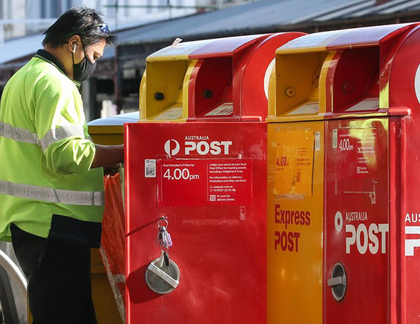

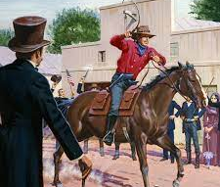
History of Communication
Couriers physically transport messages
messenger pigeons, pony express, AusPost
Can overcome great distances, but are slow and costly

Slide 4
History of Communication
Telegraphs transmit messages using signals
drums, beacons, mirrors, smoke, flags, what else (can you think of any)?
Optical telegraphs were invented in the 1790s and could propagate signals 800km in 3 minutes
Optical telegraphs were replaced by electric telegraph networks
Faster and cheaper
Notes:
Optical telegraphy is interesting case of long distance transmission

Slide 5
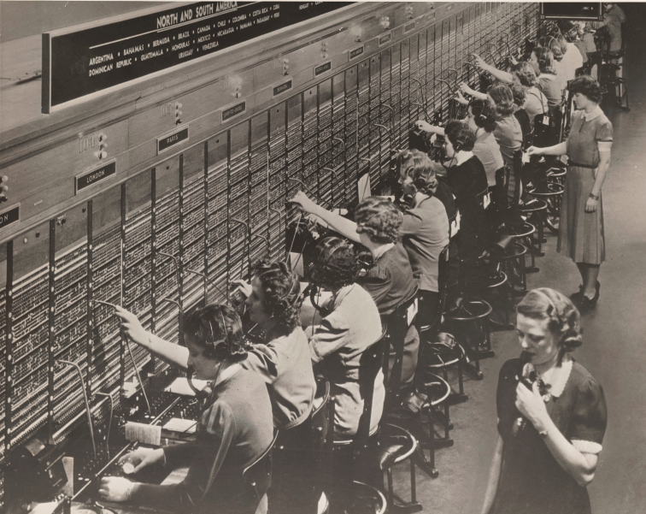
History of Communication
Electric telegraphs, and early telephone systems, still required a lot of human intervention
Coding and decoding messages
Manually switching circuits
Messages are encoded, switched, and routed automatically in computer networks
Therefore faster and cheaper

